Slide 1
Medium Access Sub Layer
Unit-III

Slide 2
OSI
Application
Presentation
Session
LOGICAL LINK sublayer
Transport
Framing
Error control
Flow control
Network
Data Link
Physical
MEDIA ACCESS sublayer
Transmission/reception of frames

Slide 3
The Medium Access Sub layer
deals with
BROADCAST NETWORKS AND THEIR PROTOCOLS
Broadcast channels are sometimes referred to as multi-access channels or random access channels.

Slide 4
Topics
Introduction
Channel Allocation problem
Multiple Access Protocols
IEEE Standard 802 for LANs
Wireless LAN
Bridges & its types.

Slide 5
Introduction
Medium Access Control (MAC) sub layer is part of Data Link layer.
In fact, it is the bottom part of DLL (interfacing with the physical layer)
This chapter deals with broadcast networks

Slide 6
Channel Allocation
Channel Allocation is a process in which a single channel is divided and allotted to multiple users in order to carry user specific tasks.
A central controller interrogates each host and allocates channel capacity to those who need it called polling.
The two main methods for channel allocation are Static Channel Allocation and Dynamic Channel Allocation.
1.Static Channel Allocation.
2. Dynamic Channel Allocation.

Slide 7
The Channel Allocation Problem
Static Channel Allocation in LANs and MANs
Dynamic Channel Allocation in LANs and MANs

Slide 8
Channel Allocation problem
Static Channel Allocation in LANs and MANs
FDM & TDM
FDM:
1.The traditional way of allocating a single channel, among multiple competing users is Frequency division multiplexing(FDM).
2. If there are N users, the bandwidth is divided into N equal-sized portions, each user being assigned one portion.
3. Here each user has a private frequency band, there is no interference between users.

Slide 9
4.When there is only a small and constant number of users, each of which has heavy load of traffic, FDM is simple and efficient.
5. When number of senders is large and continuously varying, FDM presents few problems.
6.If spectrum is cut up into N regions and <N users are interested in communication, the spectrum is wasted.
7.If more than N users want to communicate, some of them will be denied permission for lack of bandwidth.
8. Assuming that the number of users be held constant at N, dividing the channel into sub-channels is inefficient.
9.The basic problem is, when some users are quiet their bandwidth is simply lost. They are not using it, and no one else is allowed to use it either.

Slide 10
TDM:
The same arguments that apply to FDM also apply to TDM.
Each user is statically allocated every N^{th} time slot. If a user does not use the allocated slot, it just lies fallow.
The same holds if we split up the network physically.

Slide 11
Dynamic Channel Allocation
The allocation of the channel changes based on the traffic generated by the user.
If the traffic increases more channels are allocated, otherwise fewer channels are allocated to the users.
Gives better utilization and lower delay on a channel when the traffic is unpredictable.

Slide 12
Dynamic Channel Allocation in LANs and MANs
Station Model.
Single Channel Assumption.
Collision Assumption.
(a) Continuous Time.
(b) Slotted Time.
(a) Carrier Sense.(LAN)
(b) No Carrier Sense.(SATELLITE)

Slide 13
1.Station Model:
The model consists of N independent Stations, each with a program or user that generates frames for transmission. Stations are called Terminals.

Slide 14
2. Single Channel Assumption:
A single channel is available for all communication.
All stations can transmit on it and all can receive from it.
3. Collision Assumption:
If two frames are transmitted simultaneously, they overlap in time and the resulting signal is garbled. This event is called a Collision.
All stations can detect collisions.
A collided frame must be transmitted again later.

Slide 15
4a. Continuous Time:
Frame transmission can begin at any instant.
There is no master clock dividing time into discrete intervals.
4b.Slotted Time:
Time is divided into slots. Frame transmission always begins at the start of a slot.
A slot can have 0,1, or more frames, corresponding to an idle slot, a successful transmission, or a collision respectively.

Slide 16
5a. Carrier Sense:
Stations can tell if the channel is in use before trying to use it.
If the channel is sensed as a busy, no station will attempt to use it until it goes idle.
5b. No Carrier Sense:
Stations cannot sense the channel before trying to use it.
They just go ahead and transmit. Only later can they determine whether the transmission was successful.

Slide 17
Multiple Access Protocols
ALOHA
Carrier Sense Multiple Access Protocols
Collision-Free Protocols
Limited-Contention Protocols
Wavelength Division Multiple Access Protocols
Wireless LAN Protocols

Slide 18
Medium Access Sub Layer
ALOHA :
It is a random access protocol.
It was designed for WLAN but it is also applicable for shared medium.
Multiple stations can transmit the data at the same time can hence lead to collision and data being garbled.
.

Slide 19
Aloha
Pure ALOHA (Mr. Norman Abramson in 1970s)
Slotted ALOHA (Mr.Roberts in 1972)

Slide 20
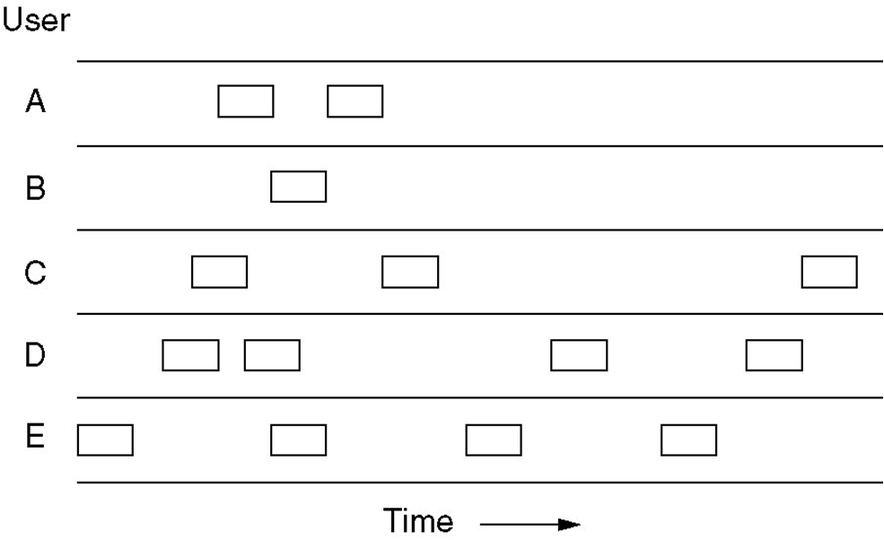
Pure ALOHA
Users transmit whenever they have data to be sent.
Fig. In pure ALOHA, frames are transmitted at completely arbitrary times

Slide 21
Systems in which multiple users share a common channel in a way that can lead to conflicts are widely known as contention system.
The frame size is fixed because the throughput of ALOHA systems is maximized.
We need to resend the frames that have been destroyed during transmission.
A collision involves two or more stations. If all these try to resend their frames after the time-out, the frames will collide again.
Pure ALOHA states that when the time-out period passes, each station waits a random amount of time before resending its frame(T_{B}).

Slide 22
Pure ALOHA has a second method to prevent congesting the channel with retransmitted frames. After a maximum no.of retransmission attempts K_{max}, a station must give up and try later.
The time-out period is equal to maximum possible round-trip propagation delay, which is twice the amount of the time required to send a frame between the two most widely separated stations(2 * T_{p} ).
The back-off time TB is a random value that depends on K.

Slide 23
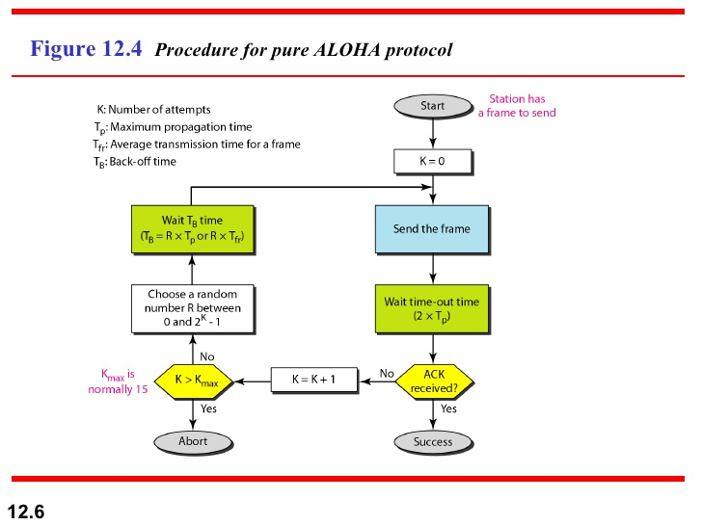

Slide 24
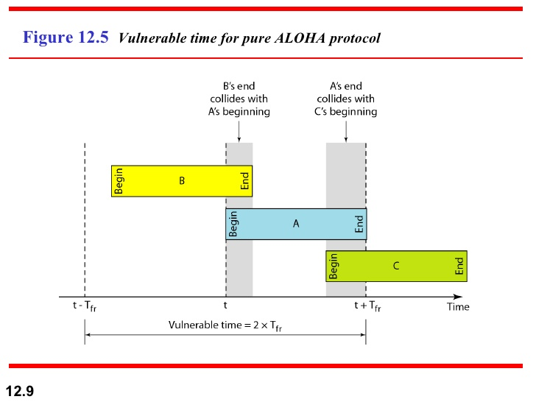

Slide 25
Pure ALOHA
Whenever two frames try to occupy the channel at the same time, there will be a collision and both will be garbled.
If the first bit of the new frame overlaps with the last bit of a frame almost finished , both frames will be totally destroyed, and both will be retransmitted later.
Throughput for pure ALOHA decreases.

Slide 26
Pure ALOHA
Disadvantage
More number of users share common channels in a way that can lead to conflicts.
More number of collisions occur.
Collision detected: stations waits a random amount of time.

Slide 27
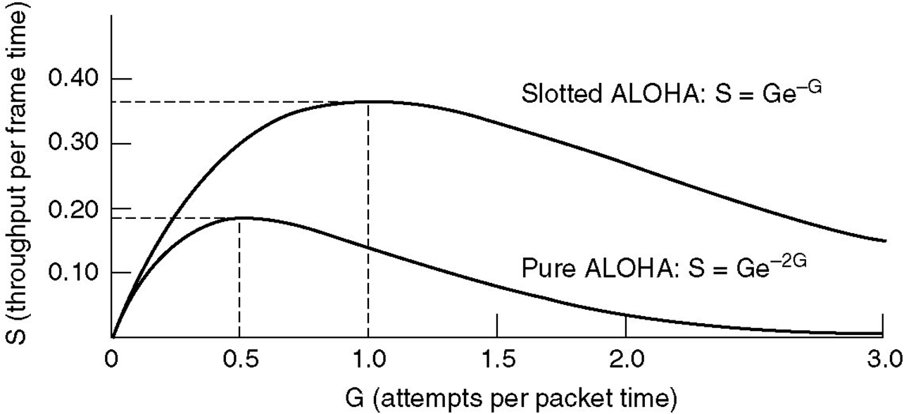
Pure ALOHA
Fig. Throughput versus offered traffic for ALOHA systems

Slide 28
Slotted aloha
Slotted ALOHA: Divide the time into discrete intervals(slots) of Tfr s, and force the station to send only at the beginning of the time slot..
Obviously, there may be a special signal needed to synchronize the clocks at all stations.
Because a station is allowed to send only at the beginning of synchronized time slot, if a station misses this, it must wait until the beginning of next time slot.
This means that the station which started at the beginning of this slot has already finished sending its frame.
Ofcourse, there is still the possibility of collision if two stations try to send at the beginning of the same slot.

Slide 29
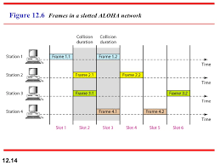

Slide 30
However, the vulnerable time is now reduced to one-half, equal to Tfr.
It can be proved that the average number of successful transmission for the slotted ALOHA is S=G * e^{-G}
Maximum throughput occurs at G=1, S=1/e or 0.368. This is twice that of pure ALOHA protocol.
In other words, if a frame is generated during one frame transmission time, then 36.8 % of these frames reach their destination successfully. This result is expected because vulnerable time is equal to the frame transmission time.
Therefore, if a station generates only one frame in this vulnerable time(and no other station generates a frame during this time), the frame will be reach its destination successfully.

Slide 31
Slotted ALOHA
Divides the time into discrete intervals
A B C D E
Disadvantage: collisions
Throughput for slotted ALOHA increases.

Slide 32
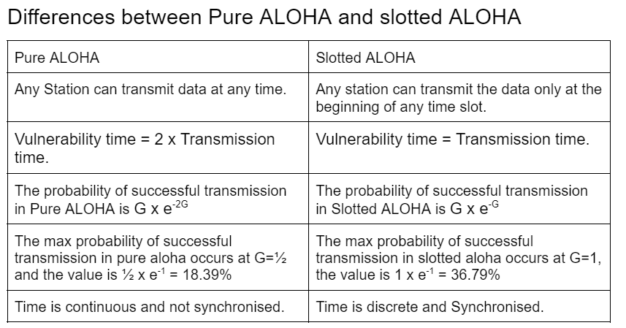

Slide 33
CSMA: Carrier Sense Multiple Access
Protocols in which stations listen for a carrier (i.e., transmission) and act accordingly are called carrier sense protocols.
Adv:
To minimize the chance of collision
Increases the performance.
  CSMA principle is “sense before transmit” or “listen before talk”.

Slide 34
CSMA Methods
1-persistent CSMA- constant length packets.
non-persistent CSMA- to sense the channel.
p-persistent CSMA

Slide 35
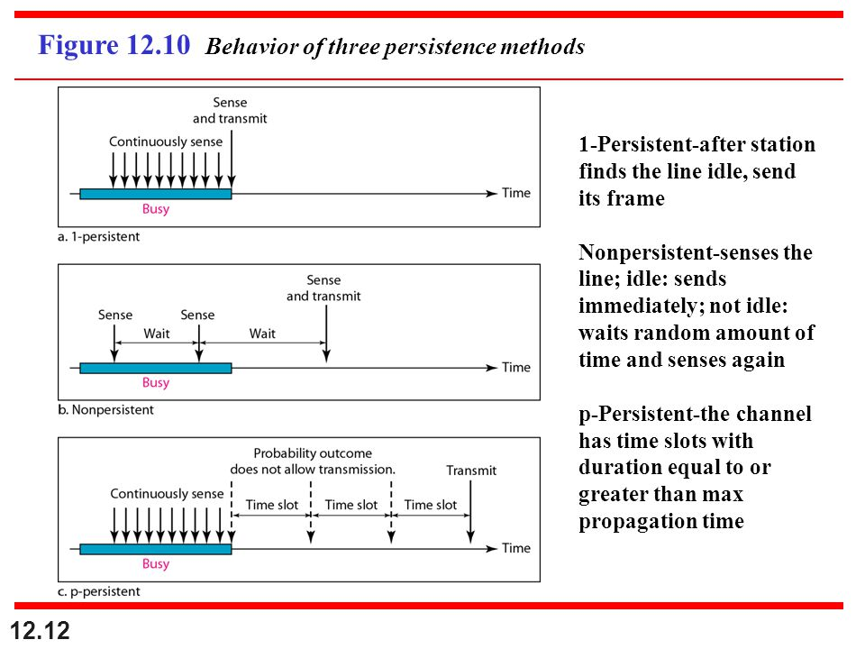

Slide 36
1-persistent
When a station has data to send, it first listens to channel to see if any one else is transmitting at that moment.
If the channel is busy, the station continuously senses the channel until it becomes idle.
When the station detects an idle channel, it transmits a frame.
If a collision occurs, the station waits a random amount of time and starts all over again.
The station transmits with a probability of 1 whenever if finds the channel idle.
This method has highest chance of collision because two or more stations may find the line idle and send their frames immediately.

Slide 37
Non-persistent CSMA
A station that has a frame to send it senses the line.
If the line is idle, it sends immediately.
If the line is not idle, it waits a random amount of time and then senses the line again.
This approach reduces the chance of collision because it is unlikely that two or more stations will wait the same amount of time and retry to send simultaneously.
This algorithm should lead to better channel utilization and longer delays than 1-persistant CSMA.

Slide 38
P-persistent CSMA
This method is used if the channel has time slots with a slot duration equal to or greater than the maximum propogation time.
It combines advantages of the other two strategies.
It reduces the chance of collision and improves efficiency.

Slide 39
P-persistent CSMA
In this method, after station finds the line idle it follows these steps:
1.With probability ‘p’, the station sends its frame.
2.With probability q=1-p, the station waits for the beginning of the next time slot and checks the line again.
a. If the line is idle, it goes to step 1.
b. If the line is busy, it acts as though a collision has occurred
wait for a random amount of time and starts again.
3.If the station intially senses the channel busy,it waits until the next slot

Slide 40
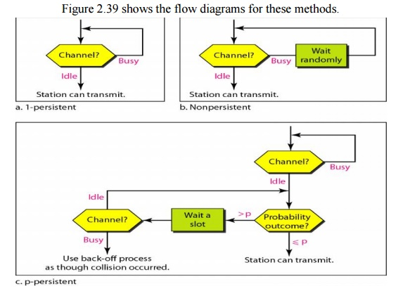

Slide 41
Carrier Sense Multiple Access with Collision Detection(CSMA/CD)
If two stations sense the channel to be idle and begin transmitting simultaneously, they will both detect the collision immidiately.
Rather than finish transmitting their frames which are irretrievably garbled anyway.they should abruptly stop transmitting as soon as the collision is detected.
Quickly terminating damaged frames saves time and bandwidth.

Slide 42
It is widely used in LANs in the MAC sublayer.
Access method used by Ethernet: CSMA/CD.

Slide 43
At the point marked t0, a station has finished transmitting its frame.
Any other station having a frame to send may now attempt to do so.
If 2 or more stations decide to transmit simultaneously, there will be a collision.
Collisions can detected by looking at the power or pulse width of the receiver signal and comparing it to the transmitted signal.

Slide 44
After a station detects a collision, it aborts its transmission, waits a random period of time and then tries again.
Therefore, model for CSMA/CD will consist of alternating contention and transmission periods with idle periods occurring when all are quite.

Slide 45
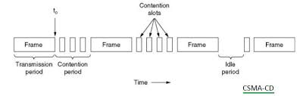

Slide 46
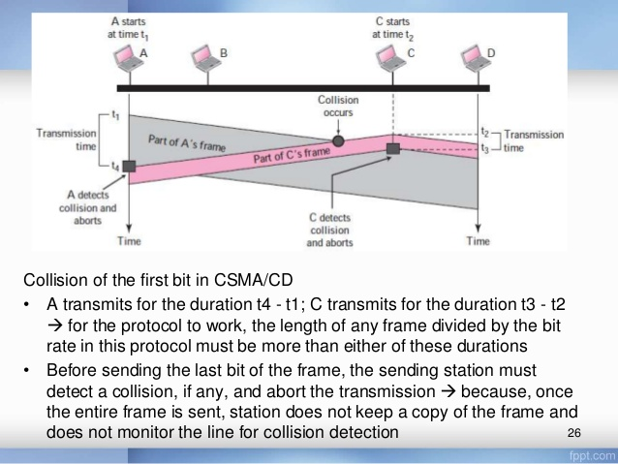

Slide 47
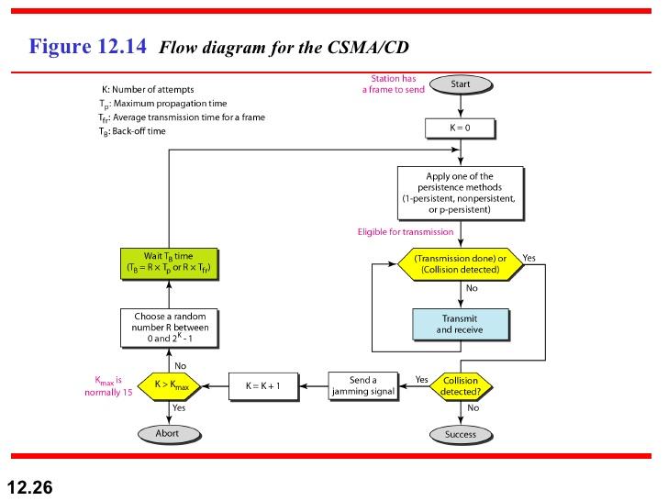

Slide 48
CSMA/CD Vs ALOHA
CSMA/CD is similar to the one for ALOHA protocol, but there are differences which as follows:
Addition of persistence methods
Frame transmission: In ALOHA, we first transmit the entire frame and then wait for an acknowledgment.
In CSMA/CD, transmission and collision is a continuous process. We do not send entire frame and then look for a collision. The station transmits and receives continuously and simultaneously.

Slide 49
Contd..
We use loop to show that transmission is a continuous process.
We constantly monitor in order to detect one of the two conditions: either transmission is finished or a collision is detected. Either event stops transmission.
When we come out of loop, if a collision has not detected, it means that the transmission is complete: the entire frame is transmitted. Otherwise, a collision has occurred.

Slide 50
Throughput of CSMA/CD
The throughput of CSMA/CD is greater than that of pure or slotted ALOHA.
The maximum throughput occurs at a different value of G and is based on the persistent method and the value of p in the p-persistent approach.
For 1-persistent method the maximum throughput is around 50 % when G=1.
For non-persistent method, the maximum throughput can go up to 90 % when G is between 3 and 8.

Slide 51
Wired LANs: Ethernet
IEEE Standards
Standard Ethernet
Fast Ethernet
Gigabit Ethernet
Ten Gigabit Ethernet.
Data Communications, Kwangwoon University
13-<number>

Slide 52
WHAT IS Ethernet?
Ethernet is the most common wired standard and technology for connecting devices within a local area network (LAN) or other networks.
It allows computers, printers, and servers to communicate by transmitting data in packets over cables like twisted-pair or fiber optic.
It uses unique MAC addresses for device identification.

Slide 53
Ethernet
It is most widely used wired LAN technologies.
Operates in the data link layer and physical layer.
Family of networking technologies that are defines in the IEEE 802.2 and 802.3 standards.
Supports data bandwidth of 10,100,1000,10,000,40,000,100,000 Mbps.

Slide 54

IEEE Standards
In 1985, the Computer Society of the IEEE started a project, called Project 802, to set standards to enable intercommunication among equipment from a variety of manufacturers. Project 802 is a way of specifying functions of the physical layer and the data link layer of major LAN protocols.
Data Communications, Kwangwoon University
13-<number>

Slide 55
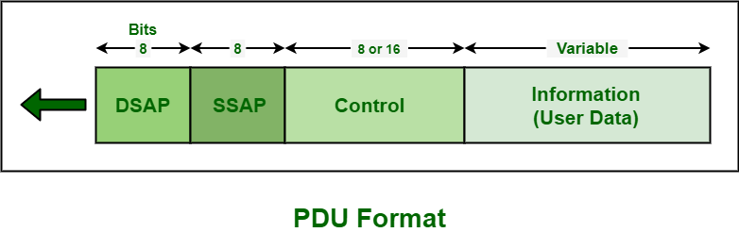
Logical Link Control (LLC)
Framing: LLC defines a protocol data unit (PDU) that is similar to that of HDLC
To provide flow and error control for the upper-layer protocols that actually demand these services.
It provides one single data link control protocol for all IEEE LANs
.
Data Communications, Kwangwoon University
13-<number>

Slide 56
Medium Access Control(MAC)
IEEE Project 802 has created a sub-layer called MAC that defines specific access methods for each LAN.
In contrast to LLC sub-layer, the MAC sub layer contains a number of distinct modules; each defines the access method and the framing format specific to the LAN protocol.
Physical layer
The physical layer is dependent on the implementation and the type of physical media used.
Data Communications, Kwangwoon University
13-<number>

Slide 57

Standard Ethernet
The original Ethernet was created in 1976 at Xerox’s Palo Alto Research Center (PARC). Since then, it has gone through four generations
Data Communications, Kwangwoon University
13-<number>

Slide 58


MAC Sublayer
Preamble: Alternate 0’s and 1’s that alerts the receiving system to the coming frame and enables it to synchronize its input timing.
Data Communications, Kwangwoon University
13-<number>

Slide 59


Addressing
Ethernet address in hexadecimal notation
The least significant bit of the first byte defines the type of address.
If the bit is 0, the address is unicast; otherwise, it is multicast
The broadcast destination address is a special case of the multicast address in which all bits are 1s
Data Communications, Kwangwoon University
13-<number>

Slide 60


Physical Layer: Ethernet
Data Communications, Kwangwoon University
13-<number>

Slide 61
This type of network involves using switches or hubs to improve network performance.
Each workstation in this network has its own dedicated connection, which improves the speed and efficiency of data transfer.
Switch Ethernet supports a wide range of speeds, from 10 Mbps to 10 Gbps, depending on the version of Ethernet being used.

Slide 62


10Base5: Thick Ethernet
10Base2: Thin Ethernet
Data Communications, Kwangwoon University
13-<number>

Slide 63


10BaseT: Twisted-Pair Ethernet
10Base-F: Fiber Ethernet
Data Communications, Kwangwoon University
13-<number>

Slide 64

Summary of Standard Ethernet
Data Communications, Kwangwoon University
13-<number>

Slide 65
Fast Ethernet
This type of Ethernet network uses cables called twisted pair or CAT5.
It can transfer data at a speed of around 100 Mbps (megabits per second).
Fast Ethernet uses both fiber optic and twisted pair cables to enable communication.

Slide 66


Fast Ethernet: Physical Layer
Topology
Implementation
Data Communications, Kwangwoon University
13-<number>

Slide 67
Gigabit Ethernet
This is an upgrade from Fast Ethernet and is more common nowadays.
It can transfer data at a speed of 1000 Mbps or 1 Gbps (gigabit per second).
Gigabit Ethernet also uses fiber optic and twisted pair cables for communication.
It often uses advanced cables like CAT5e, which can transfer data at a speed of 10 Gbps.

Slide 68

Gigabit Ethernet: Physical Layer
Topology
Data Communications, Kwangwoon University
13-<number>

Slide 69

Gigabit Ethernet: Physical Layer
Implementation
Data Communications, Kwangwoon University
13-<number>

Slide 70
10-Gigabit Ethernet
This is an advanced and high-speed network that can transmit data at a speed of 10 gigabits per second.
It uses special cables like CAT6a or CAT7 twisted-pair cables and fiber optic cables.
With the help of fiber optic cables, this network can cover longer distances, up to around 10,000 meters.

Slide 71
Wireless
Local Area Networks

Slide 72
Wireless Local Area Networks
WLAN is a local area network that uses radio communication to provide mobility to the network users while maintaining the connectivity to the wired network.
A WLAN basically, extends a wired local area network.
WLAN's are built by attaching a device called the access point(AP) to the edge of the wired network.
Clients communicate with the AP using a wireless network adapter which is similar in function to an ethernet adapter.
It is also called a LAWN is a Local area wireless network.

Slide 73
The performance of WLAN is high compared to other wireless networks.
The standards of WLAN are HiperLAN, Wi-Fi, and IEEE 802.11.
It offers service to the desktop laptop, mobile application, and all the devices that work on the Internet.
WLAN is an affordable method and can be set up in 24 hours.
Most latest brands are based on IEE 802.11 standards, which are the WI-FI brand name.

Slide 74
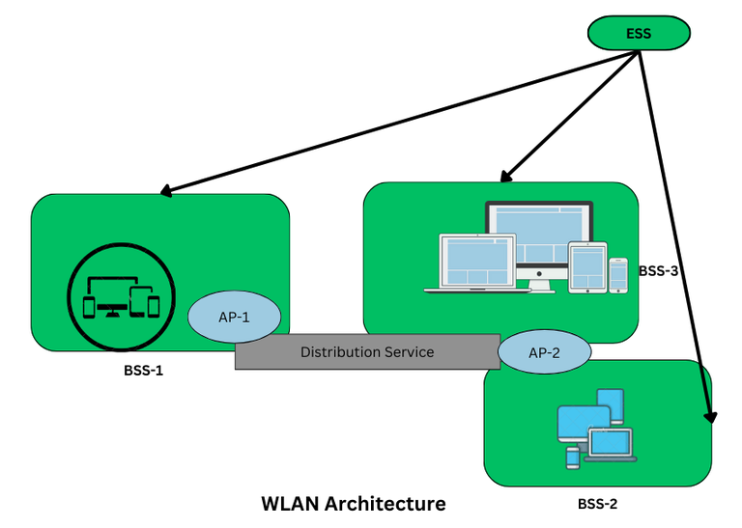

WLAN Architecture
WLAN Architecture
Components in Wireless LAN architecture as per IEEE standards are as follows:
Stations: Stations consist of all the equipment that is used to connect all wireless LANs. Each station has a wireless network controller.
Base Service Set(BSS): It is a group of stations communicating at the physical layer.
Extended Service Set(ESS): It is a group of connected Base Service Set(BSS).
Distribution Service (DS): It connects all Extended Service Set(ESS).

Slide 75
Stations: Stations consist of all the equipment that is used to connect all wireless LANs. Each station has a wireless network controller.
Base Service Set(BSS): It is a group of stations communicating at the physical layer.
Extended Service Set(ESS): It is a group of connected Base Service Set(BSS).
Distribution Service (DS): It connects all Extended Service Set(ESS).

Slide 76
Types of WLANs
Infrastructure: In Infrastructure mode, all the endpoints are connected to a base station and communicate through that; and this can also enable internet access.
A WLAN infrastructure can be set up with: a wireless router (base station) and an endpoint (computer, mobile phone, etc).
An office or home WiFi connection is an example of Infrastructure mode.
.

Slide 77
Ad Hoc:
In Ad Hoc mode WLAN connects devices without a base station, like a computer workstation.
An Ad Hoc WLAN is easy to set up it provides peer-to-peer communication.
It requires two or more endpoints with built-in radio transmission

Slide 78
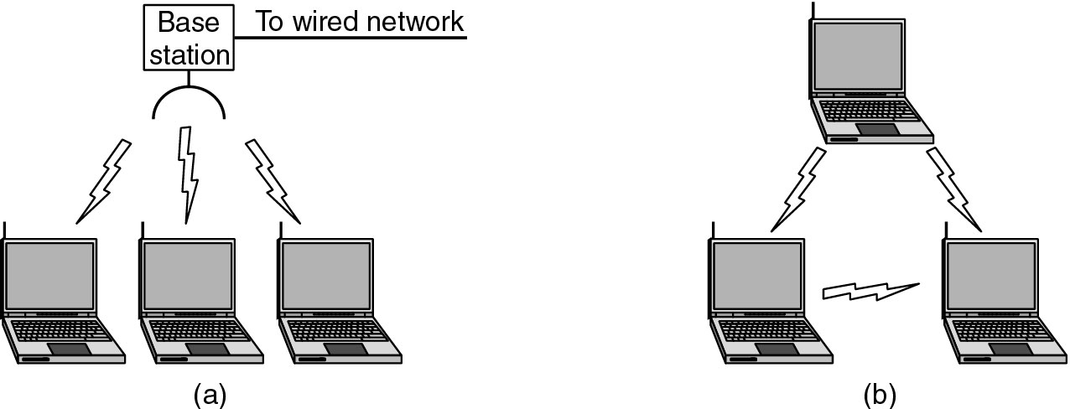
Wireless LANs
Figure 1-36.(a) Wireless networking with a base station. (b) Ad hoc networking.

Slide 79
WLAN Access Protocols
These protocols define how devices manage access to the shared wireless medium:
CSMA/CA (Carrier Sense Multiple Access with Collision Avoidance):
The primary mechanism in Wi-Fi, where devices "listen" to the channel before transmitting to avoid data collisions.

Slide 80
Advantages of WLAN
Installation speed and simplicity.
Installation flexibility.
Reduced cost of ownership.
Reliability.
Mobility.
Robustness.

Slide 81
Disadvantages of WLAN
Slower bandwidth.
Security for wireless LANs is the prime concern.
Less capacity.
Wireless networks cost four times more than wired network cards.

Slide 82
Types of Bridges
There are three types of bridges in computer networks, which are as follows:
1.Transparent Bridge:
Transparent bridges are invisible to other devices on the network. This bridge doesn't reconfigure the network on the addition or deletion of any station.
The prime function of the transparent bridge is to block or forward the data according to the MAC address.

Slide 83
2.Source Routing Bridge:
Source routing bridges were developed and designed by IBM specifically for token ring networks.
The frame's entire route is embedded with the data frames by the source station to perform the routing operation so that once the frame is forwarded it must follow a specific defined path/route.

Slide 84
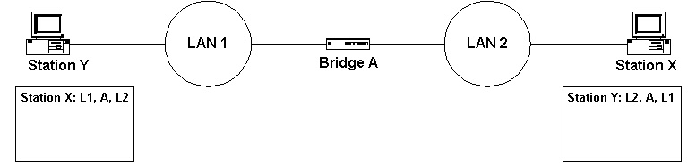

Slide 85
Translational Bridge:
Translational bridges convert the received data from one networking system to another.
It is used to communicate or transmit data between two different types of networking systems.
Like if we are sending data from a token ring to an Ethernet cable, the translational cable will be used to connect both the networking system and transmit data

Slide 86
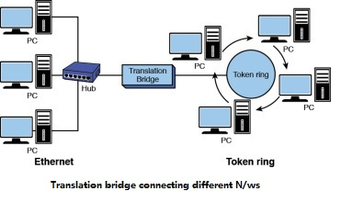

Slide 87
Advantages
Bridges can be used as a network extension like they can connect two network topologies together.
Highly reliable and maintainable.
Simple installation, no requirement of any extra hardware or software except the bridge itself.

Slide 88
Disadvantages
Expensive as compared to hubs and repeaters.
Slow in speed.
Poor performance as additional processing is required to view the MAC address of the device on the network.

